Slide 1
Environment Mapping & Obstacle Detection Using Lidars
Team Members: Youseuf Molla, Bhavik Panchal, Alka Kumari, Babajide Martins, John Kang
Faculty Advisor: Dr. Jing Ren

Slide 2
What is a Lidar? Reasons why we chose to work with Lidars!
LIDAR stands for Light Detection and Ranging.
It is a popular remote sensing method used for measuring the exact distance of an object.
Utilizing Lidar sensors provides a more accurate 3d data capture.
Reasons for working with Lidar:
Lidars are very accurate, they are used in autonomous vehicles , drones etc.
Lidars are rapidly being integrated into our daily lives . For example Lidars are becoming more accessible as it is being used in the iPhone 12 pro.

Slide 3
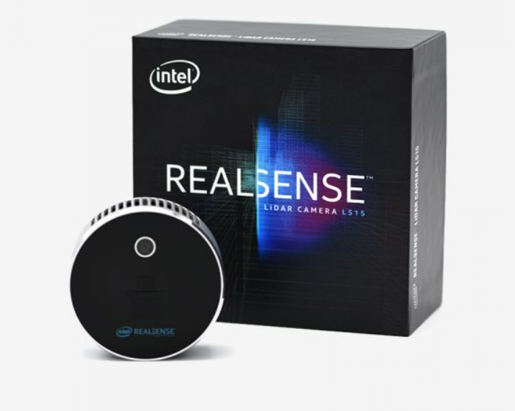
Problem Identification
Lidar : Intel RealSense L515 lidar
Environment : Indoor
Fall : 3D Mapping
Winter : Obstacle Detection

Slide 4
Current solutions
When it comes to 3D mapping, Lidar is the most accurate option indoors
-Unlike other options such as Visual SLAM. It uses only visual inputs from a camera to calculate position and orientation.
-A Lidar uses laser sensor which is both faster and more precise
It can be used in a wide range of environments and conditions.

Slide 5
Proposed Solution
Assumptions
Design process
Architecture

Slide 6
Assumptions
Indoor Environment
Stable Lidar Movement
0.25-9m Depth Capture Range
Minimal Light Interference

Slide 7
5. No Sudden Obstacle Positioning
6. 3D Surfaces detected
7. Use of a Single Lidar (Intel RealSense L515)
8. Use of PC for Processing

Slide 8
Agile Development Diagram
Requirement & Specifications
Design & Development
1
2
Evaluation & Refinement
Prototyping & Deployment
4
3

Slide 9
Design Process
After receiving the scope of the project from Professor Ren, our first task was to choose a LiDAR to work with. After our researching, we decided to work with the Intel Realsense LiDAR camera L515. We worked with the LiDAR through the Intel RealSense SDK.
Next was, choosing the 3D mapping software that was needed for this project. We decided on using RTABMAP (Real-Time Appearance-Based Mapping), which generates the 3D point clouds of the environment with real-time constraints. RTABMAP isn’t sufficiently accurate to utilize on its own, therefore post processing is needed.
For post-processing the 3D point clouds, we decided on using Open3D, which is an open source library that supports 3D data processing for Python and C++. Also, Intel RealSense support is integrated into Open3D providing better reliability.
We planned to have our LiDAR mounted on a vehicle for the Project Demo, unfortunately, the LiDAR can not compute results going at the current speed of the vehicle. We plan to resolve this issue and have a LiDAR mounted on a vehicle for the Winter Semester.

Slide 10
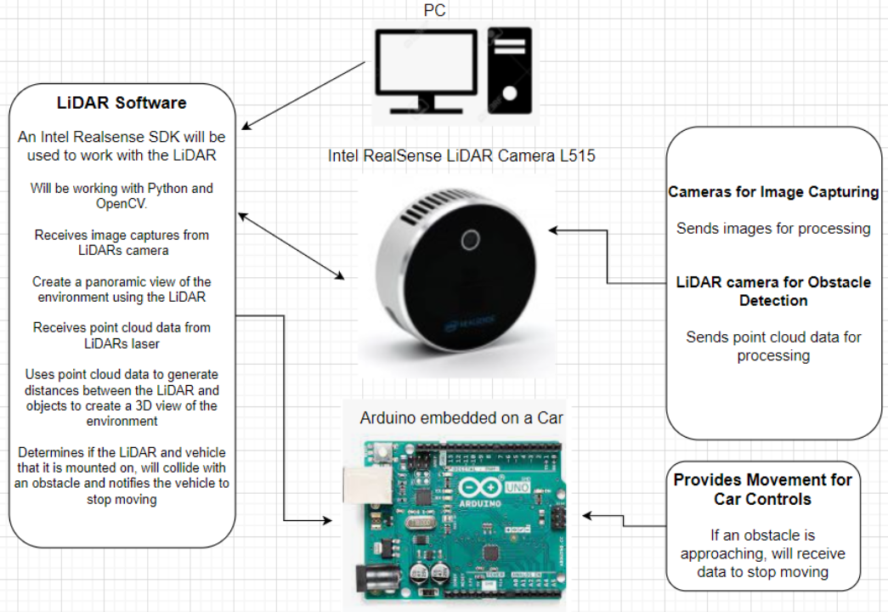
System Architecture

Slide 11
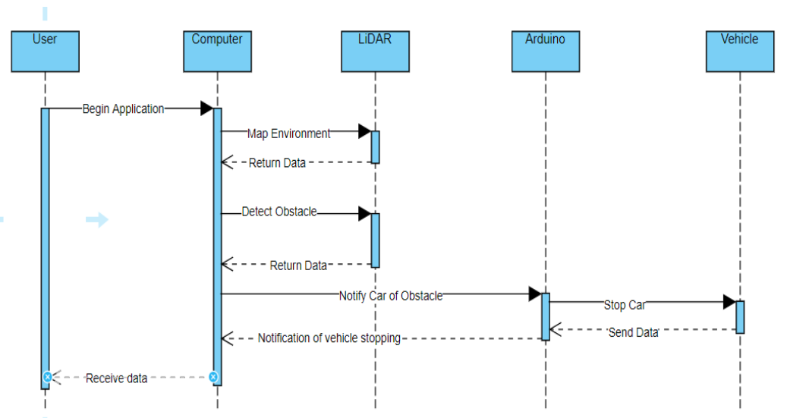
Sequence Diagram

Slide 12

Demo
3D Scanning
Post-Processing

Slide 13
Evaluation Results and Analysis
High demands for processing power
Improve existing SLAM algorithm
Reduce point cloud density by adjusting decimation value
Ensure consistent loop closure, two frames need to have significant overlap
Increase frame capture rate
Demands for more processing power
Smoother, slower movement
Software and hardware challenges for robot car

Slide 14
Challenges & Solutions
#1: Creating 3D Mapping of Environment
#2: Constructing Larger Frames from Smaller Frames
#3: Accuracy of Lidar in Motion
Solution: Initially attempted to combine frames into larger frames for mapping construction.
Solution: Ensure significant overlap between close frames to guarantee the second frame is a continuation of the first frame (loop closure).
Solution: Utilize lidar’s built-in gyroscope (detect rotation) and accelerometer (detect acceleration), to account for offset of position during real time movement.

Slide 15
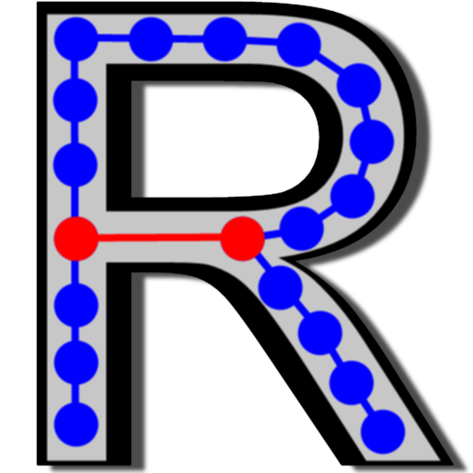
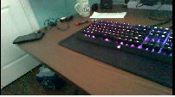
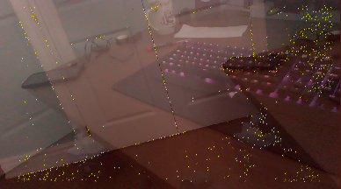
#4: Coding Implementation
#5: 3D Data Capture During Vehicle Movement
Last captured frame
Solution: Decided best approach is LIDAR based SLAM (Simultaneous Localization And Mapping) Using RTABMAP. Use of 3rd Party Software is faster and more efficient.
Solution: Need to slow down the vehicle’s movement and prevent sudden motion. Can adjust individually controlled wheels when turning, slower acceleration, add suspension, or tracks to wheels
Failed loop closure due to lack of overlaps from previous frame

Slide 16
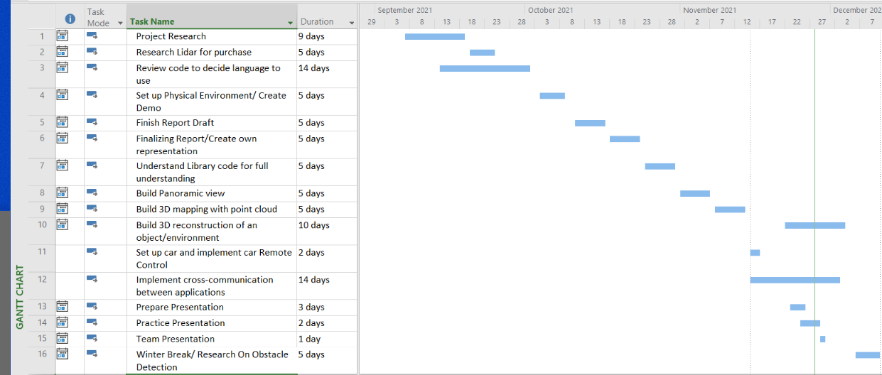
TIMELINE
Timeline outlined for the fall semester using a gantt chart

Slide 17
Future Work
Identify Obstacles
(Shapes, sizes, etc)
React to Obstacle for imminent collision
Remote car control on PC via Bluetooth
1
3
5
2
4
6
Classify Obstacles
(Static/dynamic)
Reliable 3D mapping while mounting camera on robot car
Inter Process Communication between car control and RTABMAP

Slide 18
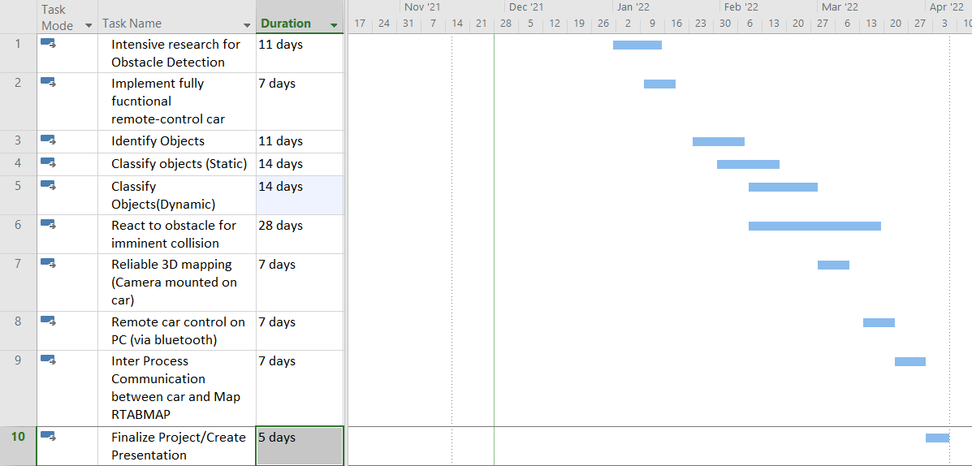
TIMELINE
Timeline proposed for the winter semester using a gantt chart.
(Subject to change)

Slide 19
Conclusion
In conclusion, we have been introduced to the general concept of the lidar device and its components, in addition to its functionalities and usages. Adhering to the overall objective of this project which is to use this device in autonomous vehicle to help in identifying,classifying obstacles and reacting to obstacles for imminent collision while prioritizing safety to the autonomous vehicle.
And to accomplish the overall goal of this project, we have established the necessary steps and also identified the parts necessary to reach the end goal, and specifically for this fall semester we have implemented the 3D environment mapping using the lidar mounted on a remote control car embedded with an arduino platform which would be a benchmark heading towards the next semester with the task of identification, classification and reaction to obstacles for imminent collision as the number one goal.

Slide 20
THANKS!
Questions ?

